Slide 1

Global Economic and
Demographic Trends Analysis
Name : Yahavarshini E
Date : 24-04-2025

Slide 2
Project Overview
This project analyzes global economic and demographic indicators such as GDP, population, and migration.
It uncovers patterns and relationships across income groups, population and countries to support data-driven decision.
Tools : MYSQL & POWER BI

Slide 3
Dataset Description
Countries World (SQL Database)
Source: Provided SQL file
Includes country-level data like:
Population, Area, Population Density
Net Migration, Infant Mortality Rate
GDP per Capita, Literacy Rate
Phones per 1000 people, Climate
Coastline Ratio, Arable/Other Land %
Birthrate, Deathrate
Sector-wise GDP: Agriculture, Industry, Services
Population Per Country (Excel)
Population data from 1960 to 2017
Contains Country Name, Code, and various population indicators
Meta Data (CSV File)
Country details like:
Region, Income Group, and Special Notes
GDP by Country 1960–2016 (CSV File)
GDP data across years
Includes Country Name, Code, and GDP indicators
Data Cleaning
Handled Missing Values
Removed Inconsistencies in Population and GDP data
Merged Meta Data to Countries Data
Merged All GDP data

Slide 4
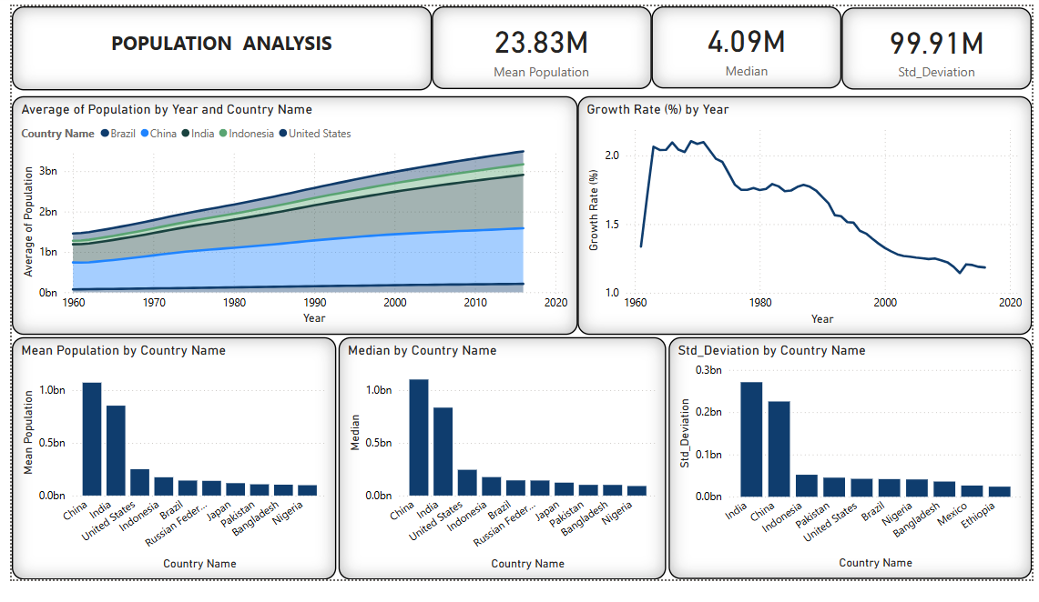
Dashboard Overview

Slide 5
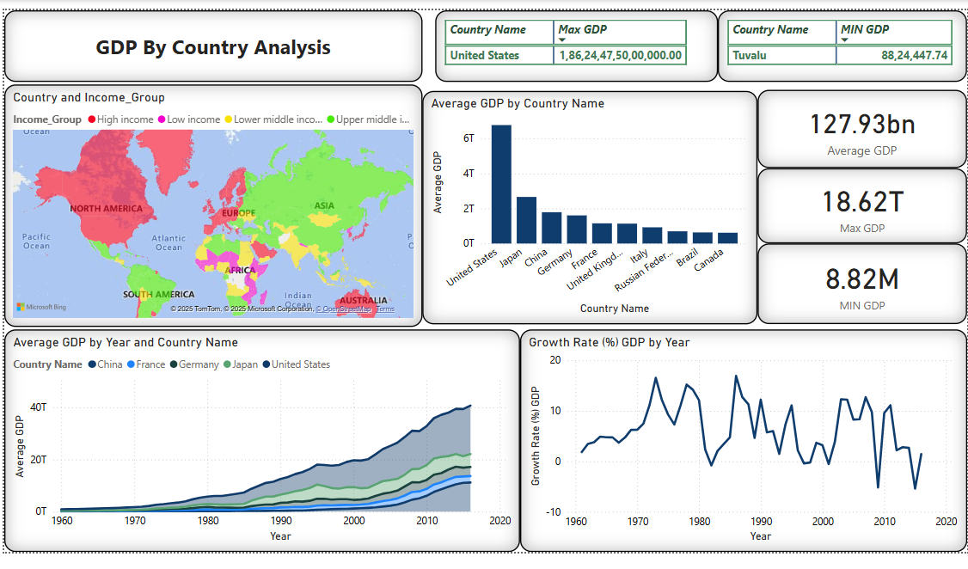

Slide 6
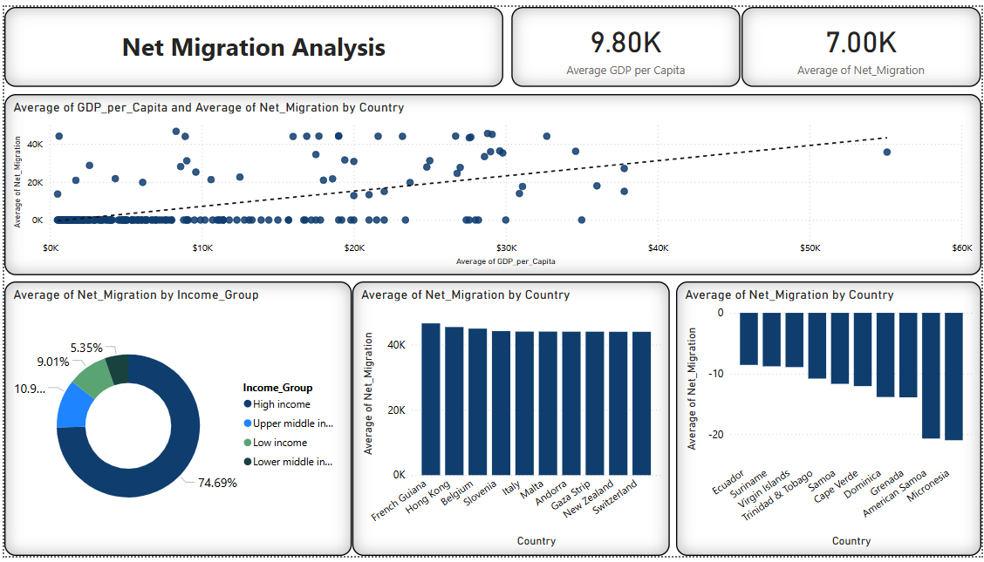

Slide 7
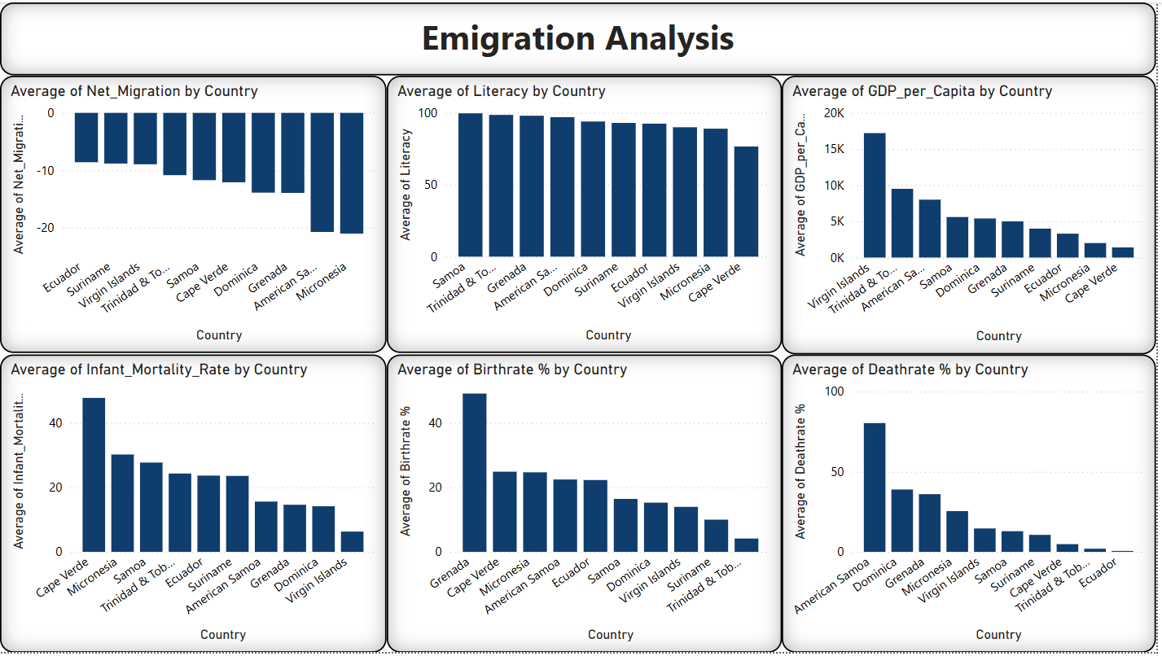

Slide 8
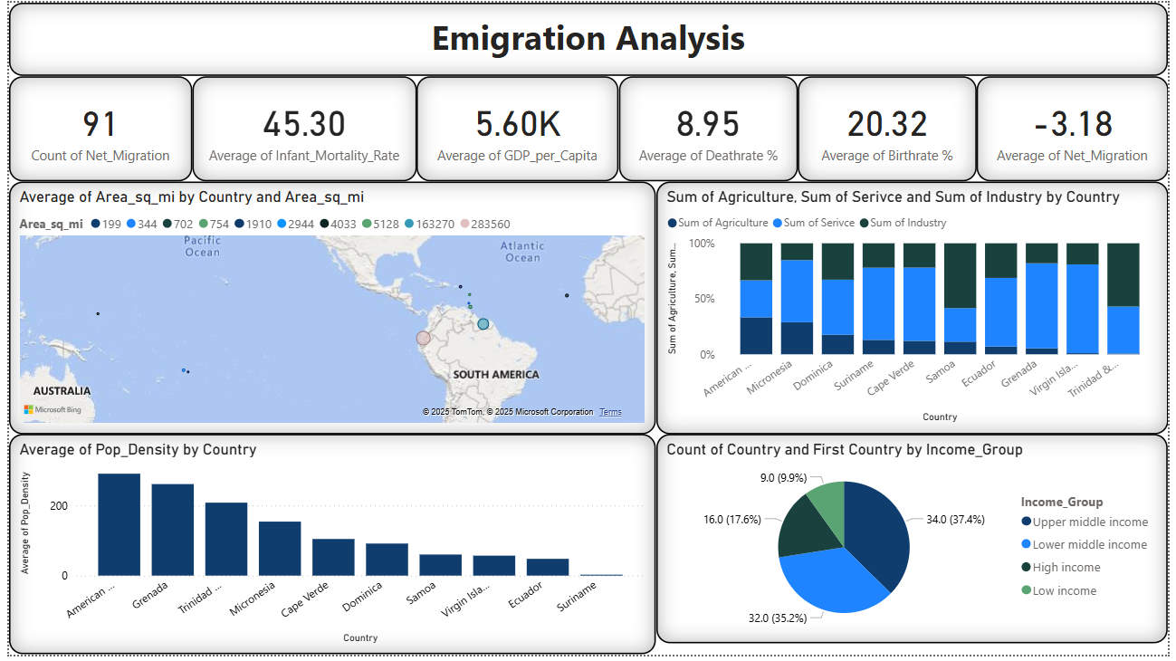

Slide 9
Key Insights
Countries with higher GDP per capita tend to have higher literacy rates and attract more migrants.
High-income nations dominate in literacy and net migration, showing strong education and economic opportunities.
Low income regions face emigration due to limited opportunities.
The service sector is the main economic contributor globally, while agriculture still plays a key role in developing regions.
Birth and death rates are higher in some countries like Hong Kong, indicating demographic pressure.
Income and region heavily influence a country’s performance in education, economy, migration, and agriculture.

Slide 10
Conclusion
Countries with stronger economies usually have better education and attract more migrants.
Many low-income countries still face challenges like low literacy and lower economic growth.
The service sector is the main part of the economy in most countries, but agriculture is still important in developing regions.
Population changes and climate differences affect how countries grow and what they need to focus on.
A country’s income and location play a big role in its progress and development.
Income levels also influence population movement and sectoral development.
Future Recommendation
Invest in Education
Support Sustainable Agriculture
Develop Smart Migration Policies
Promote Economic Growth
Plan for Aging Populations
Strengthen International Cooperation

Slide 11

THANK YOU

